Slide 1


XML to Objects
&
Objects to XML
Explore the world of Java and XML integration. Learn how to seamlessly convert XML to Java objects and vice versa with the JAXB API.
By
Parth & Kunal

Slide 2

Introduction
XML stands for eXtensible Markup Language. It is a markup language that allows users to create their own customized markup tags to describe content. Java objects are instances of classes that represent data and have associated methods to modify or interact with that data. In this presentation, we will explore how to convert XML to Java objects and vice versa.

Slide 3
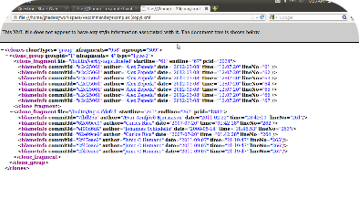
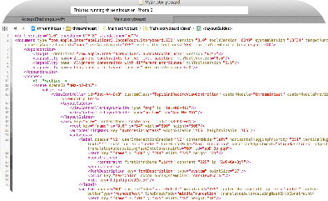
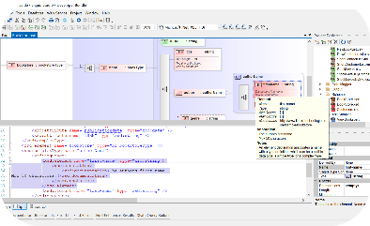
- Explanation of XML
Anatomy of an XML File
XML Code Example
XML Schema
XML documents contain a set of elements, each representing a part of the content, and a set of attributes that provide additional information about the elements. The file is enclosed in a root element that encompasses all other elements.
Each element is enclosed in a start tag and an end tag. Element names are case-sensitive and can't contain spaces or special characters. Attributes are specified in the start tag and appear in name-value pairs.
XML can be validated against a schema, which specifies the structure and data types of elements and attributes, ensuring that an XML document is well-formed and conforms to a predefined set of rules.
Notes:
Anatomy of an XML File:
XML (Extensible Markup Language) is a structured and text-based data format used to represent information.
An XML file typically consists of the following components:
Root Element:
Elements:
Attributes
Content:
Comments:
Processing Instructions:
Entity References:
XML Code Example:
An XML code example represents a snippet of XML data. Here's a simple XML example:xmlCopy code
<person>
<name>John Doe</name> <age>30</age> </person>
In this example, <person> is the root element, and it contains nested elements (<name> and <age>) with their respective data.
XML Schema:
An XML Schema (XSD) is a way to formally describe the structure and constraints of an XML document.
It defines the elements, attributes, data types, and relationships within an XML document.
XML Schemas are used for validation, ensuring that XML data adheres to a specific structure.
Here's a basic example of an XML Schema for the XML code example above:xmlCopy code
<xs:schema xmlns:xs="http://www.w3.org/2001/XMLSchema"> <xs:element name="person"> <xs:complexType> <xs:sequence> <xs:element name="name" type="xs:string"/> <xs:element name="age" type="xs:positiveInteger"/> </xs:sequence> </xs:complexType> </xs:element> </xs:schema>
This schema defines that a <person> element should contain a <name> element of type xs:string (string) and an <age> element of type xs:positiveInteger (positive integer).

Slide 4
- Explanation of Java objects
What are Java Objects?
Object-Oriented Programming
Object Inheritance
Inheritance is a mechanism by which one class acquires the properties and methods of another class. It allows for code reuse and promotes modularity and extensibility.
Java objects are instances of classes that represent data and have associated methods to modify or interact with that data. They are the fundamental building blocks of object-oriented programming in Java.
Object-oriented programming (OOP) is a programming paradigm based on the concept of "objects", which can contain data, in the form of fields, and code, in the form of procedures, known as methods.

Slide 5
Converting XML to Java Objects
1
JAXB API
The Java Architecture for XML Binding (JAXB) is a framework that allows Java developers to map Java classes to XML representations.
Marshalling
2
Marshalling is the process of converting Java objects to XML representations. It involves generating XML tags that map to Java class properties.
3
Unmarshalling
Unmarshalling is the process of converting XML to Java objects. It involves reading XML tags and instantiating Java objects with the appropriate data.

Slide 6
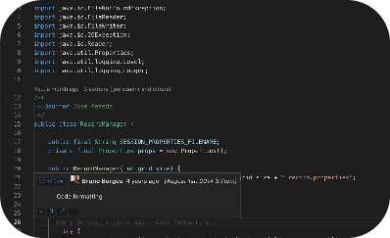
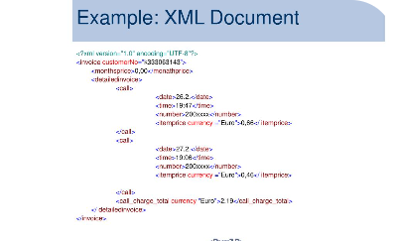
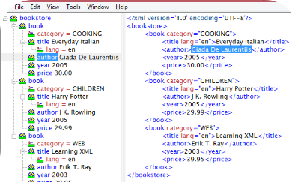
Converting Java Objects to XML
JAXB API
Marshalling
Unmarshalling
The Java Architecture for XML Binding (JAXB) also allows Java developers to map Java classes to XML representations. It is the preferred API for binding Java objects to XML.
Marshalling is the process of converting Java objects to XML representations. It involves generating XML tags that map to Java class properties. The resulting XML document can be edited or stored as an XML file.
Unmarshalling is the process of converting XML to Java objects. It involves reading XML tags and instantiating Java objects with the appropriate data. The resulting Java objects can be used in Java applications.
Notes:
JAXB API:
JAXB is a Java API that provides a framework for mapping XML data to Java objects and vice versa. It allows you to define how XML elements and attributes should be mapped to Java classes and fields using annotations.
JAXB is part of the Java SE (Standard Edition) platform, which means you don't need to add additional libraries for basic JAXB functionality.
Marshalling:
Marshalling is the process of converting Java objects into XML data. This means taking your Java objects and generating XML that represents their structure and data.
In JAXB, marshalling is performed by a Marshaller instance. You provide a Java object, and the Marshaller generates the corresponding XML representation.
Unmarshalling:
Unmarshalling is the process of converting XML data into Java objects. It involves taking XML and creating Java objects that mirror the structure and data found in the XML.
In JAXB, unmarshalling is performed by an Unmarshaller instance. You provide XML data, and the Unmarshaller generates the corresponding Java object.

Slide 7
Program for XML to Object Convertion :
import javax.xml.bind.JAXBContext;
import javax.xml.bind.JAXBException;
import javax.xml.bind.Unmarshaller;
import java.io.StringReader;
public class XMLToObjectExample {
public static void main(String[] args) {
String xmlData = "<person><name>John Doe</name><age>30</age></person>";
try {
JAXBContext jaxbContext = JAXBContext.newInstance(Person.class);
Unmarshaller unmarshaller = jaxbContext.createUnmarshaller();
StringReader reader = new StringReader(xmlData);
Person person = (Person) unmarshaller.unmarshal(reader);
System.out.println("Name: " + person.getName());
System.out.println("Age: " + person.getAge());
} catch (JAXBException e) {
e.printStackTrace();
}
}
}
class Person {
private String name;
private int age;
public String getName() {
return name;
}
public void setName(String name) {
this.name = name;
}
public int getAge() {
return age;
}
public void setAge(int age) {
this.age = age;
}
}
Notes:
Import necessary Java classes and JAXB-related classes.
Define the XMLToObjectExample class, which contains the main method for the program.
Define a sample XML data as a string. This XML data represents a person element with name and age sub-elements.
Start a try-catch block to handle exceptions.
Create a JAXBContext for the Person class. This context will be used to configure JAXB for the given Java class.
Create an Unmarshaller instance. The unmarshaller is used to convert XML data into Java objects.
Create a StringReader to read the XML data. The StringReader is used to provide the XML data for unmarshalling.
Unmarshal (convert) the XML data into a Person object by using the unmarshal method of the Unmarshaller. The result is stored in the person variable.
19-20. Access and print the name and age properties of the Person object.
Close the try block.
25-28. Define the Person class, which represents the Java class that corresponds to the XML data. This class has fields for name and age, along with getter and setter methods.
The program uses JAXB to unmarshal the provided XML data and create a Person object, which is then used to access and print the name and age properties. Any exceptions that occur during the process are caught and printed to the console.

Slide 8
Program for Object to XML Convertion :
import javax.xml.bind.JAXBContext;
import javax.xml.bind.JAXBException;
import javax.xml.bind.Marshaller;
import java.io.StringWriter;
public class ObjectToXMLExample {
public static void main(String[] args) {
// Create a Person object
Person person = new Person();
person.setName("John Doe");
person.setAge(30);
try {
// Create a JAXBContext for the Person class
JAXBContext jaxbContext = JAXBContext.newInstance(Person.class);
// Create a Marshaller
Marshaller marshaller = jaxbContext.createMarshaller();
// Marshal the Person object to XML
StringWriter writer = new StringWriter();
marshaller.marshal(person, writer);
// Print the XML representation
System.out.println(writer.toString());
} catch (JAXBException e) {
e.printStackTrace();
}
}
}
class Person {
private String name;
private int age;
public String getName() {
return name;
}
public void setName(String name) {
this.name = name;
}
public int getAge() {
return age;
}
public void setAge(int age) {
this.age = age;
}
}
Notes:
Import necessary Java classes and JAXB-related classes.
Define the ObjectToXMLExample class, which contains the main method for the program.
6-10. Create a Person object and set its name and age properties. This object will be converted to XML.
Start a try-catch block to handle exceptions.
Create a JAXBContext for the Person class. This context will be used to configure JAXB for the given Java class.
Create a Marshaller instance. The marshaller is used to convert Java objects into XML data.
Create a StringWriter to write the XML data. The StringWriter is used to store the XML representation of the Java object.
Marshal (convert) the Person object to XML by using the marshal method of the Marshaller. The resulting XML is stored in the StringWriter.
22-26. Print the XML representation of the Person object to the console.
28-31. Close the try block.
33-36. Define the Person class, which represents the Java class that corresponds to the XML data. This class has fields for name and age, along with getter and setter methods.
The program uses JAXB to marshal the Person object into XML data and then prints the XML representation to the console. Any exceptions that occur during the process are caught and printed to the console.

Slide 9

Conclusion
1
Benefits of Converting XML to Java Objects
- Easier processing and manipulation of XML data
- Facilitates effective communication between different applications
2
Benefits of Converting Java Objects to XML
- Enables systems to communicate with each other without knowing each other's internal data formats
- Eases the development of distributed systems

Slide 10


References
https://jaxb.java.net/guide/Java Architecture for XML Bindingfrom and into XML documents.
https://www.tutorialspoint.com/xml/xml_quick_guide.htm
https://docs.oracle.com/javase/tutorial/jaxb/intro/index.html

Slide 11
Thank You !

